Slide 1
WHAT MAKES LAWYERS HAPPY?
REDEFINING PROFESSIONAL SUCCESS
Larry Krieger, FSU Law
lkrieger@law.fsu.edu

Slide 2
DYSFUNCTIONAL SUCCESS PARADIGM?
Primary study findings:
Current (external) success paradigm does Not predict satisfaction or well-being.
Personal/subjective factors Do predict satisfaction and well-being.

Slide 3
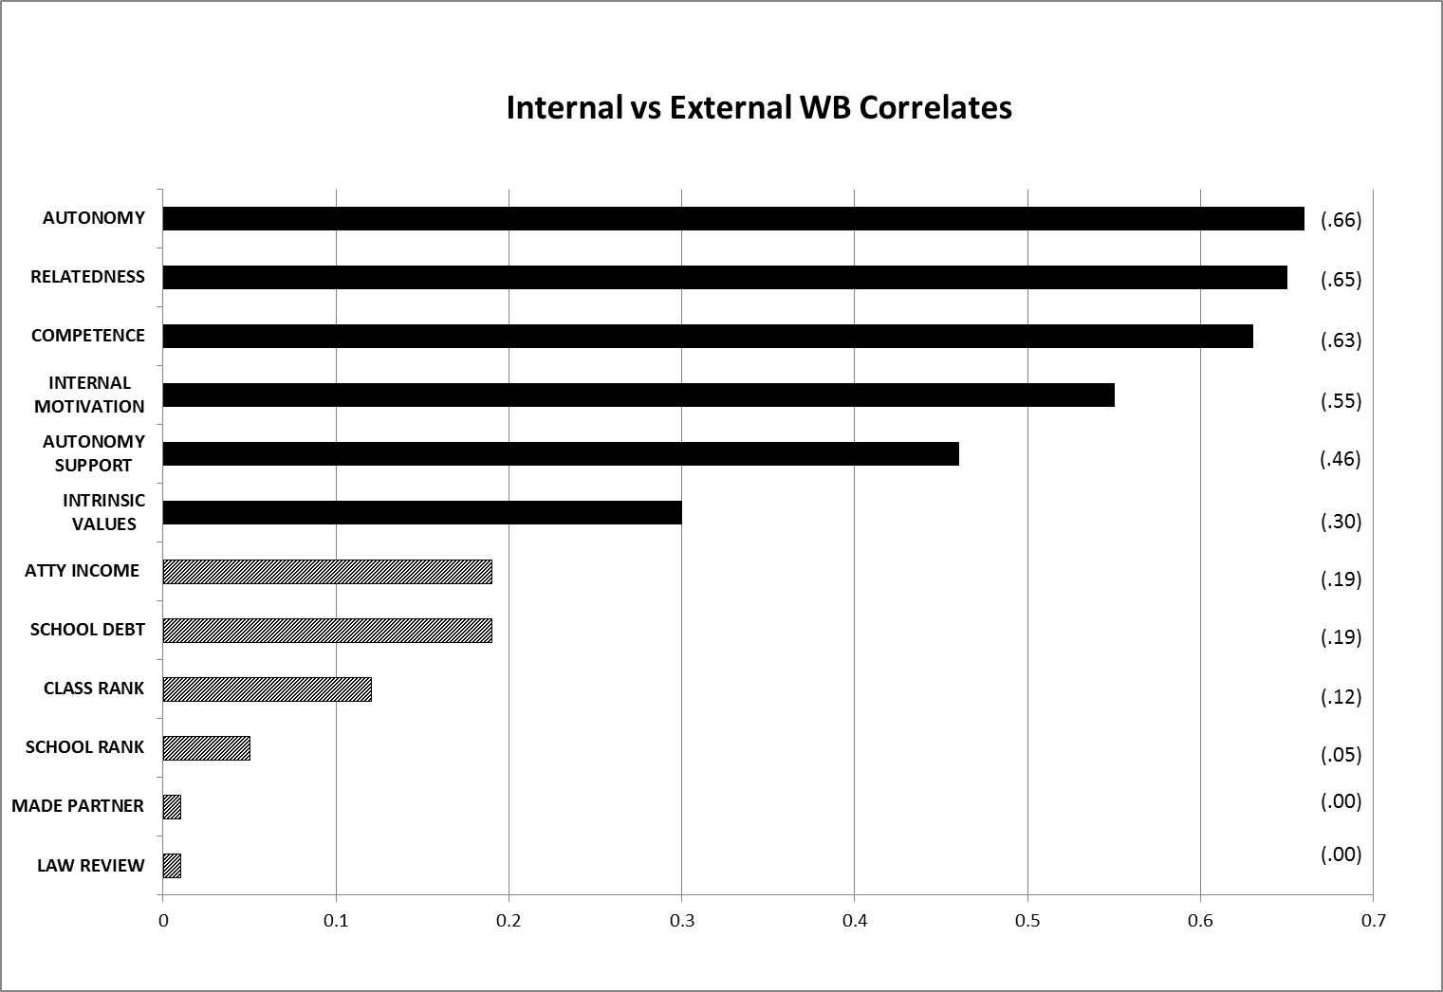
Subjective vs. Objective WB factors

Slide 4
FIVE TIERS WB FACTORS (standardized correlations)
 | SWB
Tier 1 AUTONOMY RELATEDNESS COMPETENCE INTERNAL MOTIV. | .66 .65 .63 .55
Tier 2 AUTON. SUPPORT INTRINSIC VALUES | .44 .30
Tier 3 VACATION DAYS CHILDREN MARRIED/LT EXERCISE ALCOHOL USE PRAYER (AFFIL.) | .23 .20 .18 .18 -.12 .07
Tier 4 INCOME SCHOOL DEBT CLASS RANK SCHOOL RANK LAW JOURNAL MADE PARTNER BILLABLE HRS. | .19 .19 .12 .05 .01 .00 -.10
Tier 5 AGE OTHER DEMOG. | .17 .00-.03
”

Slide 5
CONTRAST 1: Income, Law Grades, & Happiness, 4 Lawyer Groups
Lowest grades and pay (Service lawyers)
--vs.--
Highest grades and pay (Prestige lawyers)
But: Service Lawyers are Happier.

Slide 6
CONTRAST 2: “MAKING PARTNER”
Junior partners: have status and 69% higher earnings. But……
Well-being no better than senior associates.

Slide 7
CORE QUESTIONS FOR US
Can we call it success if it does not generate happiness?
How to educate for a new paradigm of success?

